Slide 1
Designs documentation for Website
Alvin Udenze
22020498

Slide 2

SITE MAP FOR MY WEBSITE.
Home page
HOME PAGE
Find us page
About us page
Deals page
Notes:
This is my site map for my website .

Slide 3
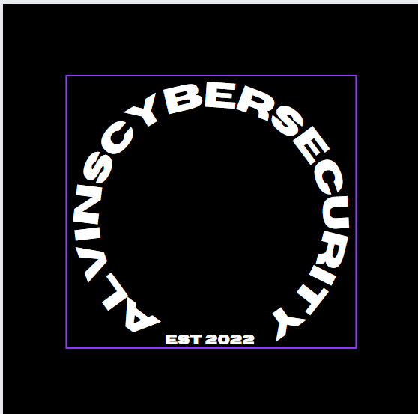
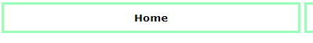
House style of my website
Colour scheme
This is my website logo
On the website that we are creating we want to use the font Trajan pro, for the webname/logo “alvinscybersecurity”. We chose this font as we felt that it was simple and effective. We made sure the that the font was big and bold so that it stands out against all of the other buttons and text. We also made sure that the logo was easy to read and professional by keeping the colours on the logo simple. The colour scheme for the logo is “Black and white so it stounds out against the color scheme of the website . For the rest of the font I will be using “Calibri (body).
This is an example of what a button on the website look likes.

Slide 4
Lay out of my website
Website logo
page title
Button
Button
Button
Button
Main content of the website
Footer of the website

Slide 5
Home page
Website logo
page title
Button
Button
Button
Button
Main content of the website
Footer of the website

Slide 6
Findus page
Website logo
page title
Button
Button
Button
Button
Navigation image
Main content of the website
Footer of the website

Slide 7
About us page
Website logo
page title
Button
Button
Button
Button
Main content of the website
image
Footer of the website

Slide 8
Deals page
Website logo
page title
Button
Button
Button
Button
Main content of the website
Footer of the website

Slide 9
HCI consideration
-I have made this layout so that I can ensure that the pages throughout my website are consistent and look professional.
-I will include a navigation bar on every page, It will be placed at the top of the page so that the user can scroll up and go to which page they want to go to.
-There will also be a title for every page , this will be displayed at the top alongside the alvincybersecurity logo.
-The main content of the page will be placed in the middle of the website, interactive things such as maps and images will be placed in the main content
-Below there will be a footer, If I use this in all pages it will make the design consistent throughout
You can see I have made sure that the navigation bare is hyperlinked buttons.
The logo is also hyperlinked so that when the user clicks it, it returns to the home page.

Slide 10
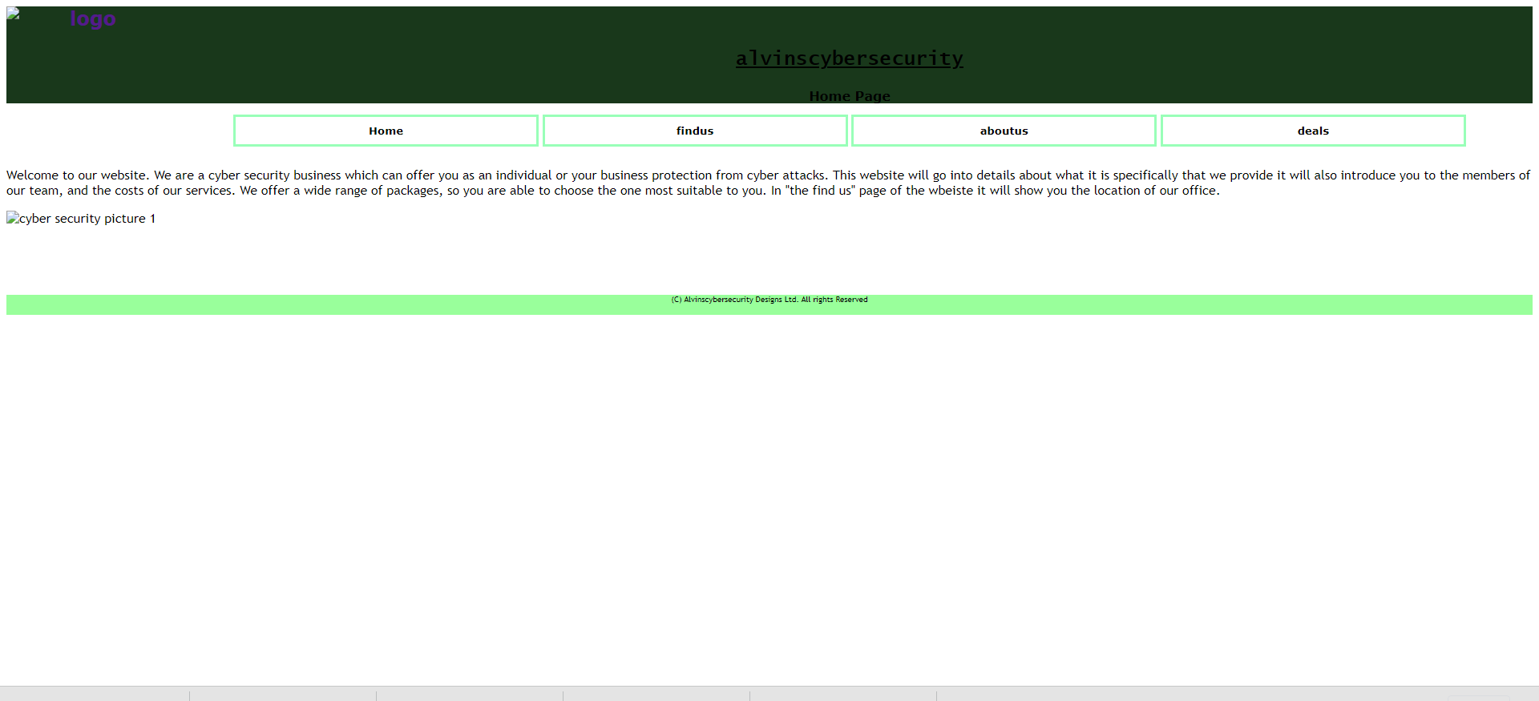

Slide 11
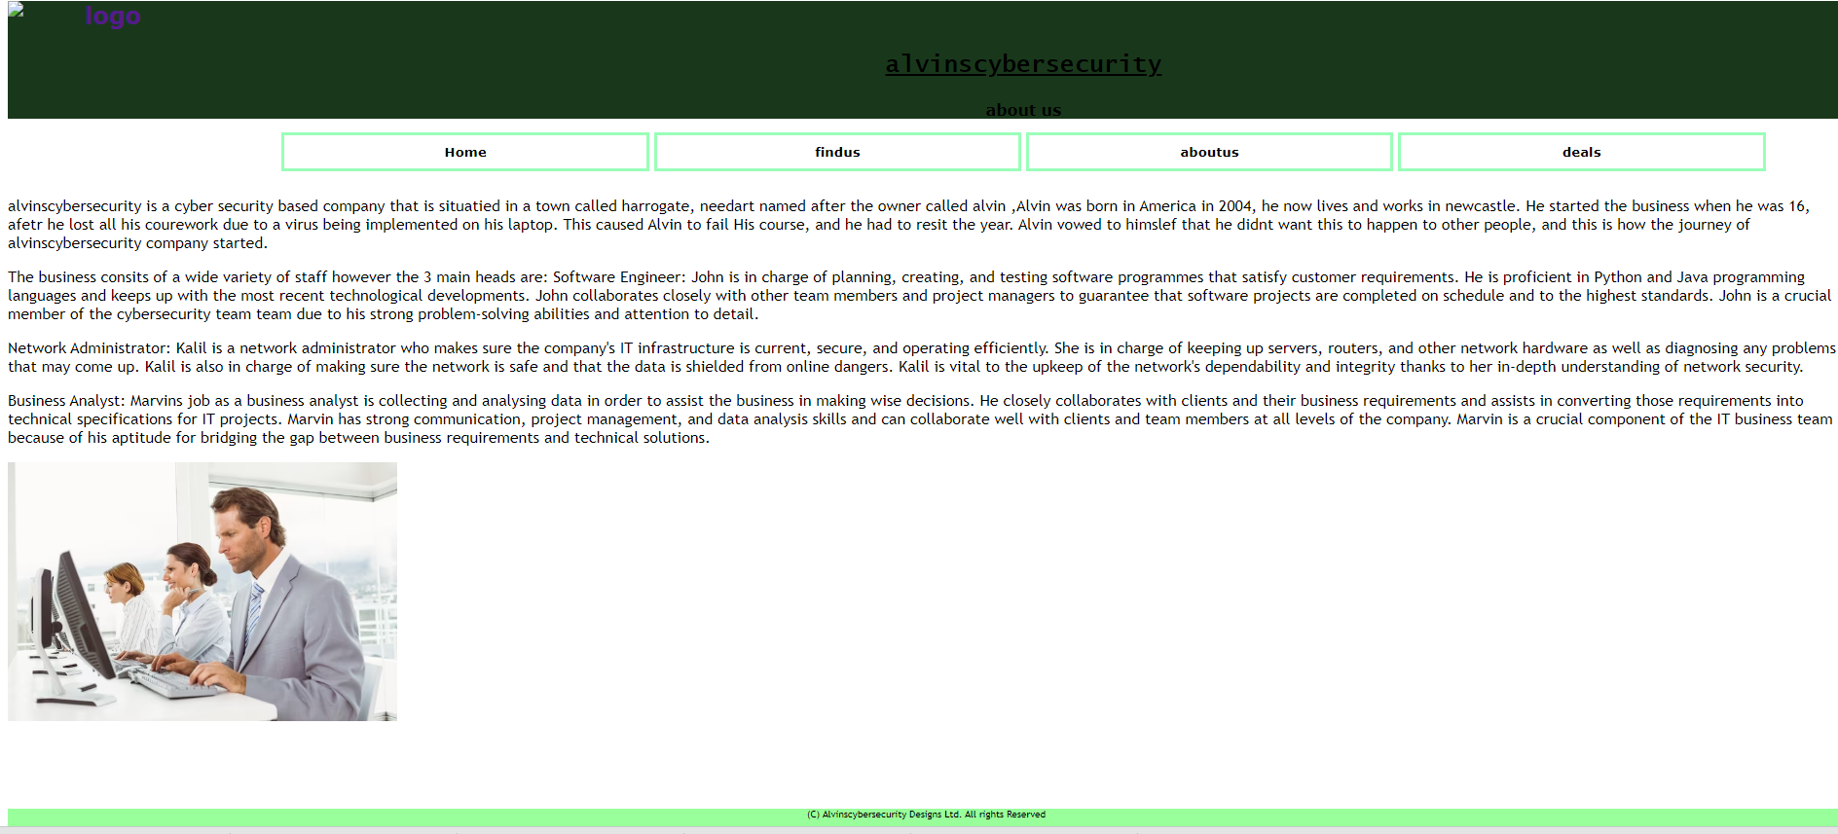

Slide 12
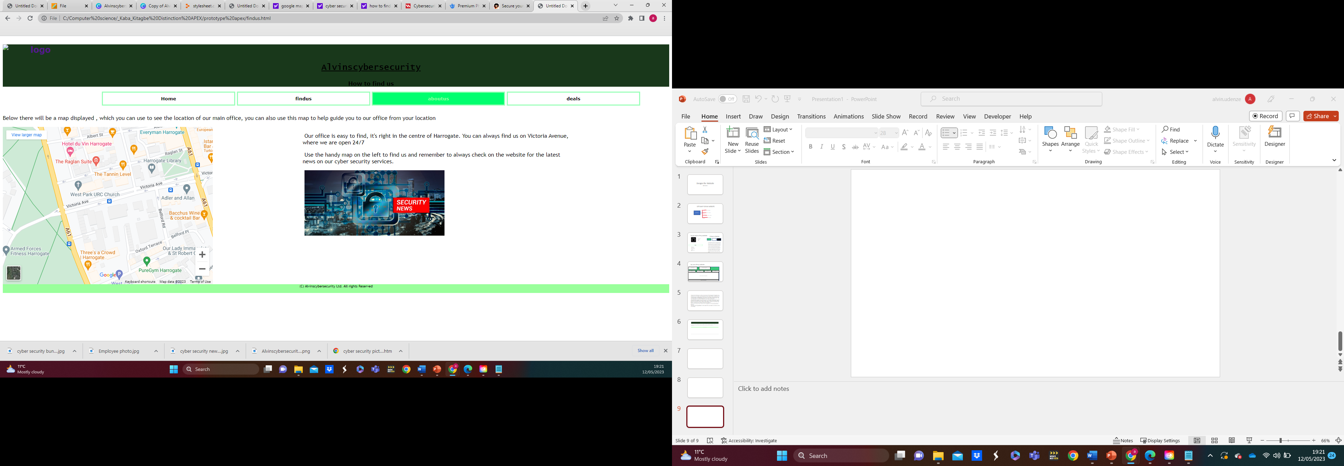

Slide 13
